Slide 1



Hack-7-Days
X
Tezos India x GTBIT
Guru Tegh Bahadur Institute of Technology
TEAM NAME : TECH TITANS
1

Slide 2
HACKER LOG
TEAM NAME: TECH TITANS
PROJECT TITLE: TRAPEZIUM
SHASHWAT GUPTA
KUSHAGRA KAUSHIK
LAKSHYA MISHRA
2

Slide 3
PROBLEM STATEMENT
To create a beginner friendly NFT market place for tezos blockchain.
The lack of a decentralized and transparent platform for buying, selling, and trading NFTs on the Tezos blockchain hinders the growth of the NFT ecosystem and the potential for artists and creators to monetize their work. A secure and user-friendly NFT marketplace is needed to address this problem. Hence, the idea of trapezium appears.
Trapezium offers artists and creators a secure and user-friendly platform to showcase and monetize their work, which is a real-life problem faced by many artists in the traditional art market. Trapezium helps to address issues of data breaches, hacking, and fraudulent activities that are prevalent in centralized marketplaces. By providing a decentralized platform, Trapezium can ensure that transactions are transparent and secure, thereby reducing the risk of fraud and data breaches.
3

Slide 4
Your Solution / Product / Services
01
The basic idea was to make a user and beginner friendly platform on tezos blockchain where artists can monetize their art and create NFTs for trading.
02
We made a smart contract and deployed it on ghostnet server, we then made functions to connect wallet, generate NFTs and instruction banner for beginners.
03
Users can buy or sell NFTs by connection their wallet, artists can monetize their art.
4

Slide 5
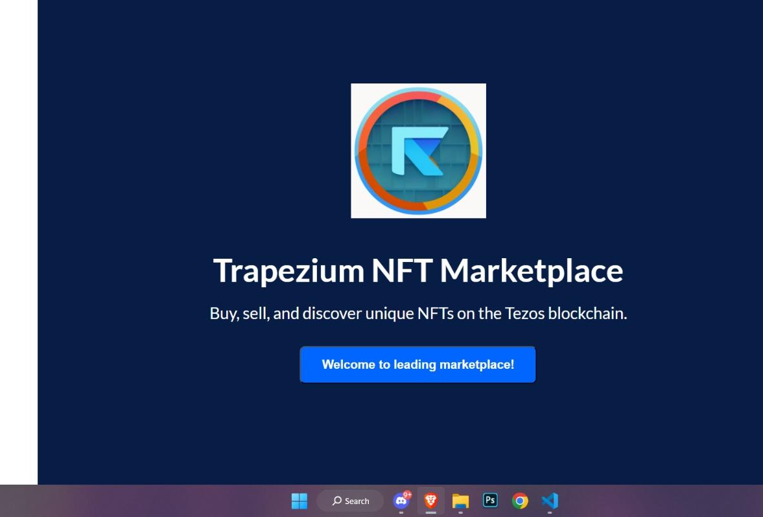
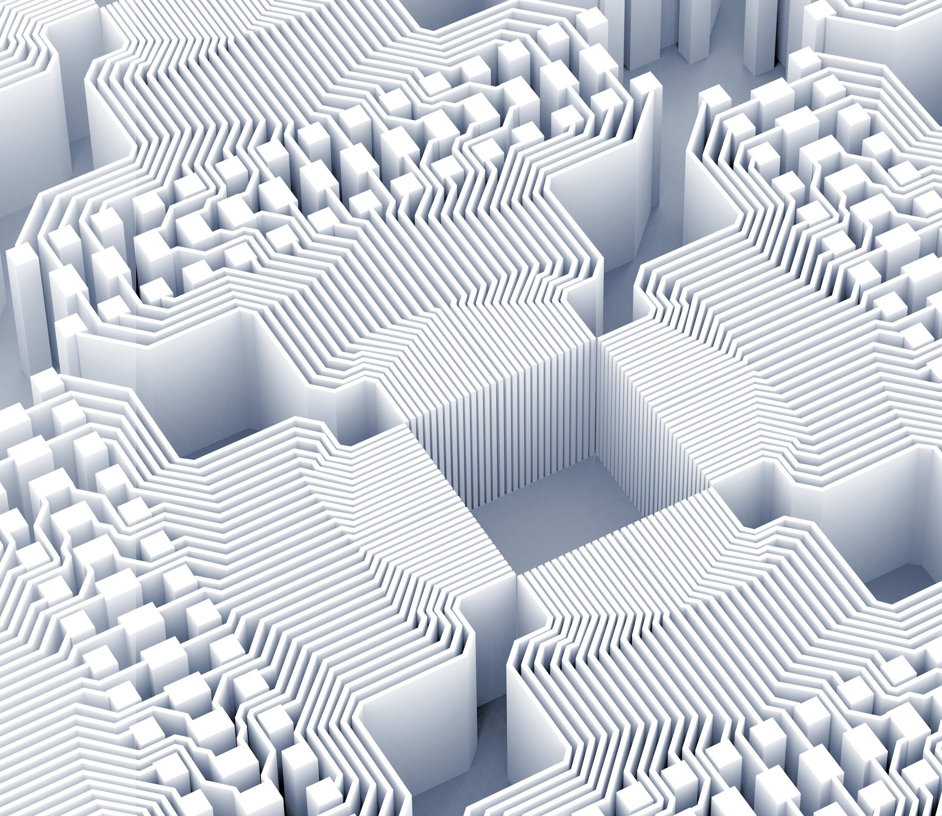
Product Demo
Live deployed application link –
https://tezosnftmarketplace.vercel.app/
5

Slide 6
TECHNOLOGIES USED
Javascirpt
Python
Smartpy
Reactjs
taquitoJS
Pinata API
6

